Slide 1

#Hack-A-Roo2019
Vipra
Courtesy Shuttle
Neha Navgale,
Dharani Muli,
SaiKumar SeelapuReddy
Teja Devarapalli

Slide 2
Project Overview:
Build a uber style hailing app for the specific organization to provide convenient transportation for their customers. App should allow patrons to request a pickup. As soon as a request is sent with the location, the driver of the nearest shuttle will be notified of the pickup location. Once the driver accepts the pickup, it will automatically route the driver to the patron’s location with the least distance and time option.

Slide 3
Highlights and Value additions:
Created web application to electronically create organization admins, drivers and shuttles with validations.
A mobile which will allow patrons to request for pick and view the Estimated time of arrival.
Identifying and allocating least ETA shuttle to patron with respect to driver approval.
Approve or Reject the request.
Automatically routing the driver to the patron’s location with the least distance and time option with a real time tracking of shuttle location.
Web application of organization admin to view their specific organization’s drop off and pick ups information.
Run on both Android and IOS.

Slide 4
Brief about our application:
Web Application:
Below type of users can login to their respective tasks
App owner
Organizations Admin
Manage Organizations and Admins
Add new “Line of Business” (Organization)
Create an account for Organization Admin
View lists of Line Of Business and their specific admins
Manage Drivers and Shuttles
Add Drivers to their organization and assign a shuttle to them
Add Shuttles and their specific driver
View list of Drivers and Shuttles
Dashboard to track drop-off and pickup requests in real time

Slide 5
Brief about our application:
Cross platform Mobile Application:
Patron can create an account.
Login and select source and destination specific to the organization they belongs to
Able to view all the nearest shuttles
Book a ride and view estimated time of arrival
2. Shuttle Drive can login to the account created by Org. Admin.
Login and view the nearest requests
Accept or Reject the booking requests
Automatically routed to the patron’s location with the least distance and time option with a real time tracking of shuttle location

Slide 6
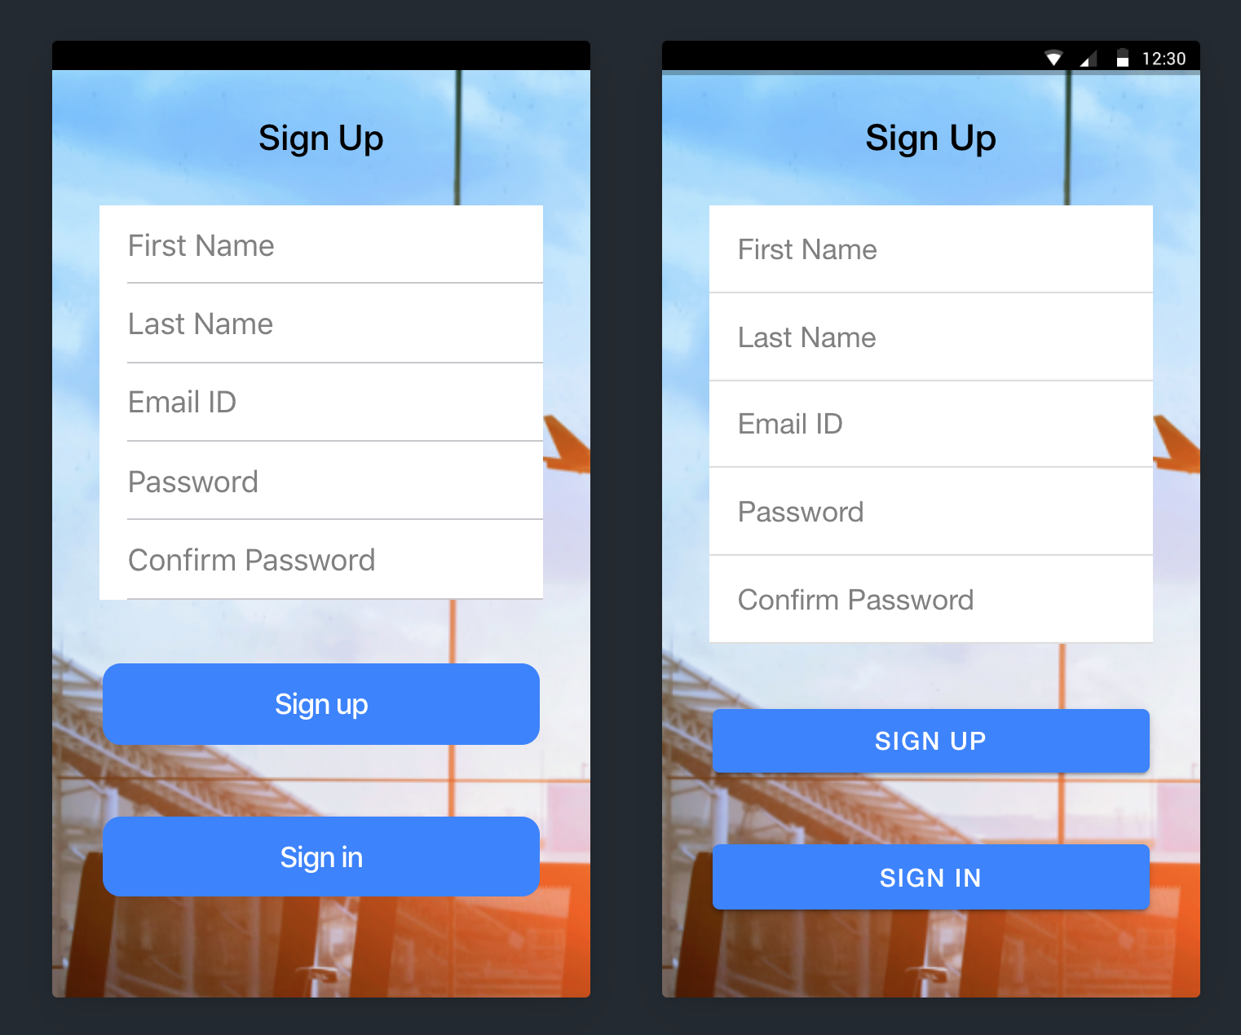
Patron Sign up

Slide 7
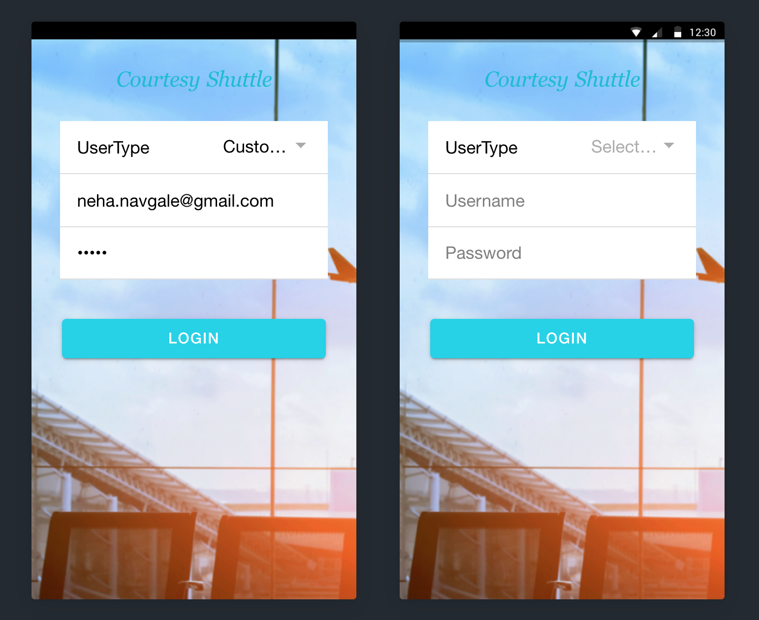
Patron Log in

Slide 8
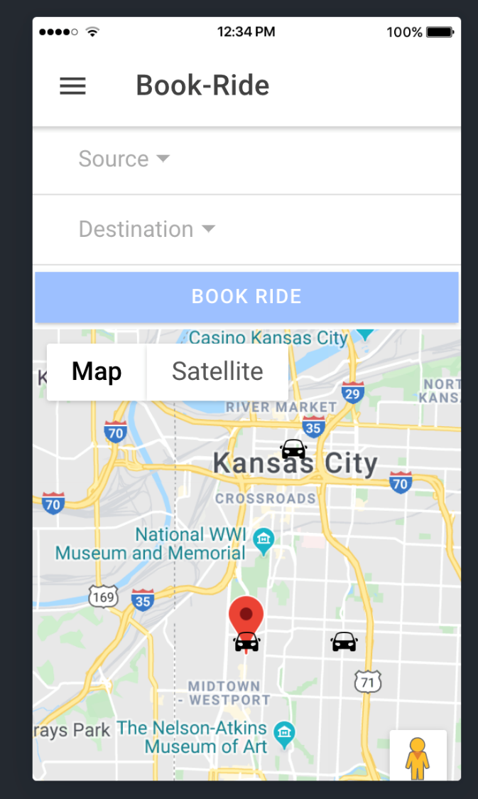
Book Ride Screens

Slide 9
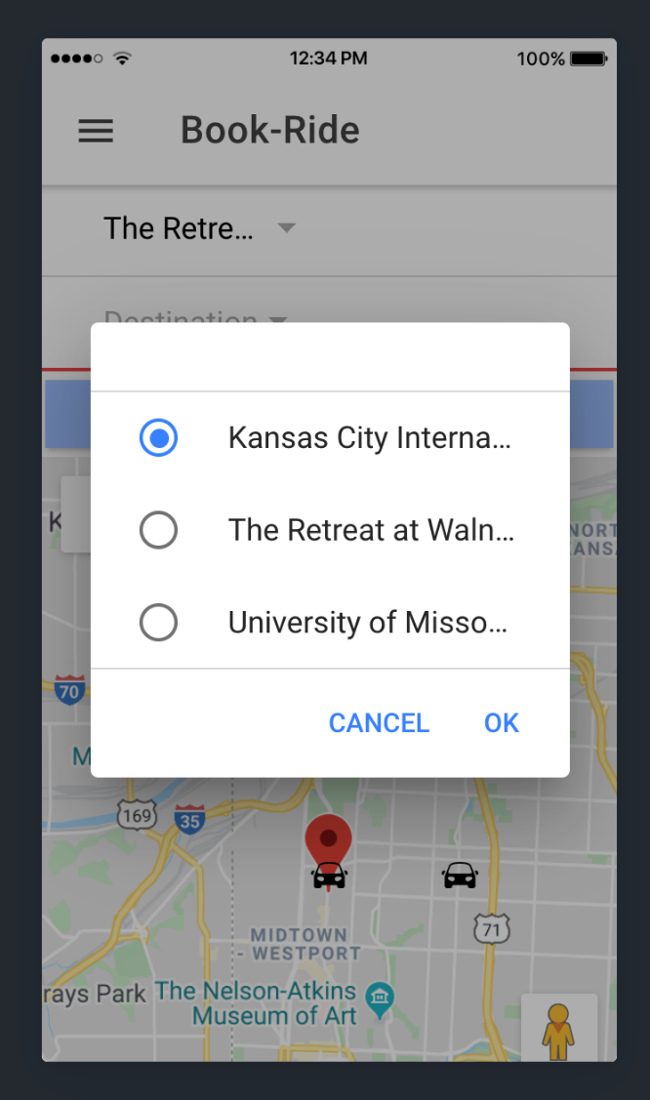
Select Source

Slide 10
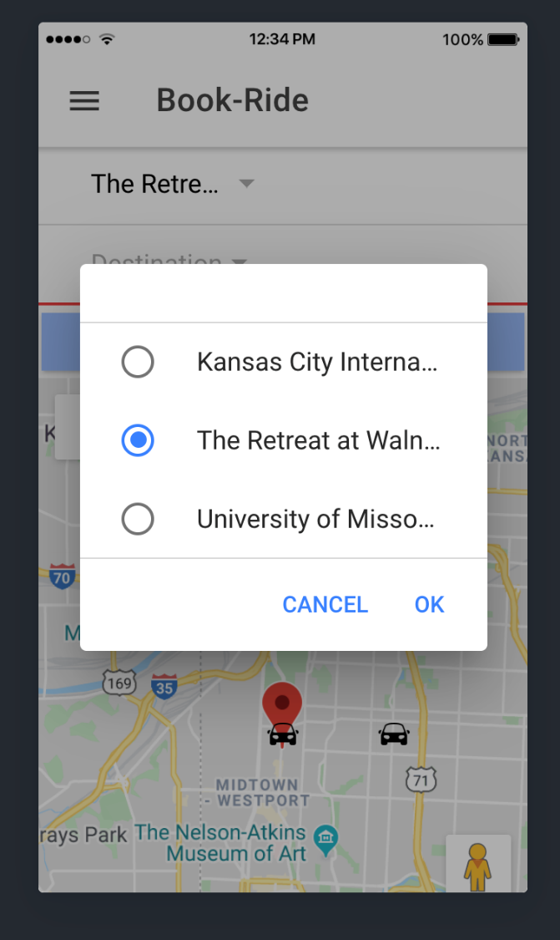
Select Destination

Slide 11
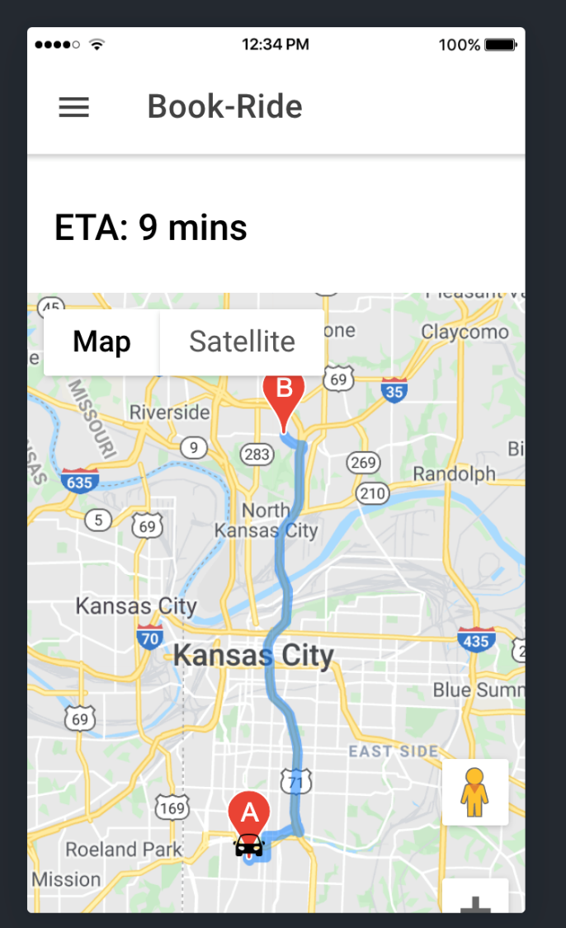
ETA

Slide 12
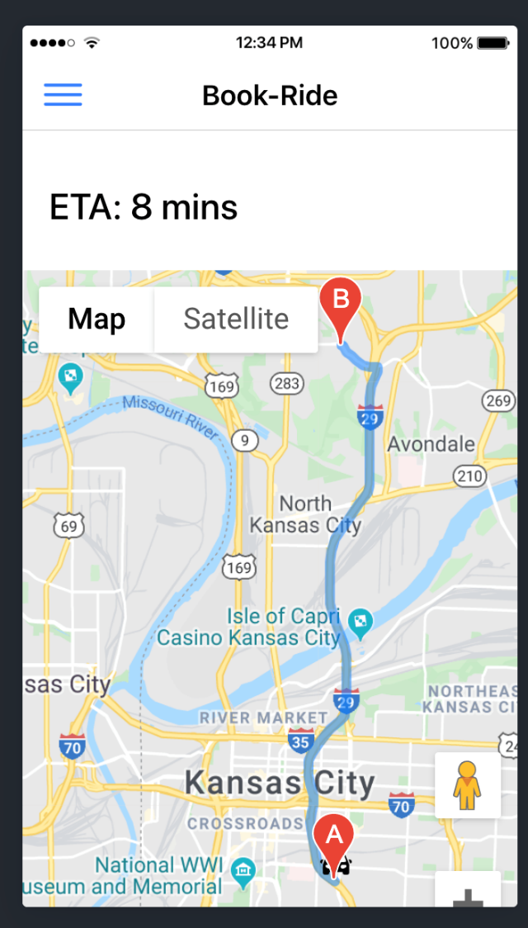
Live ETA

Slide 13
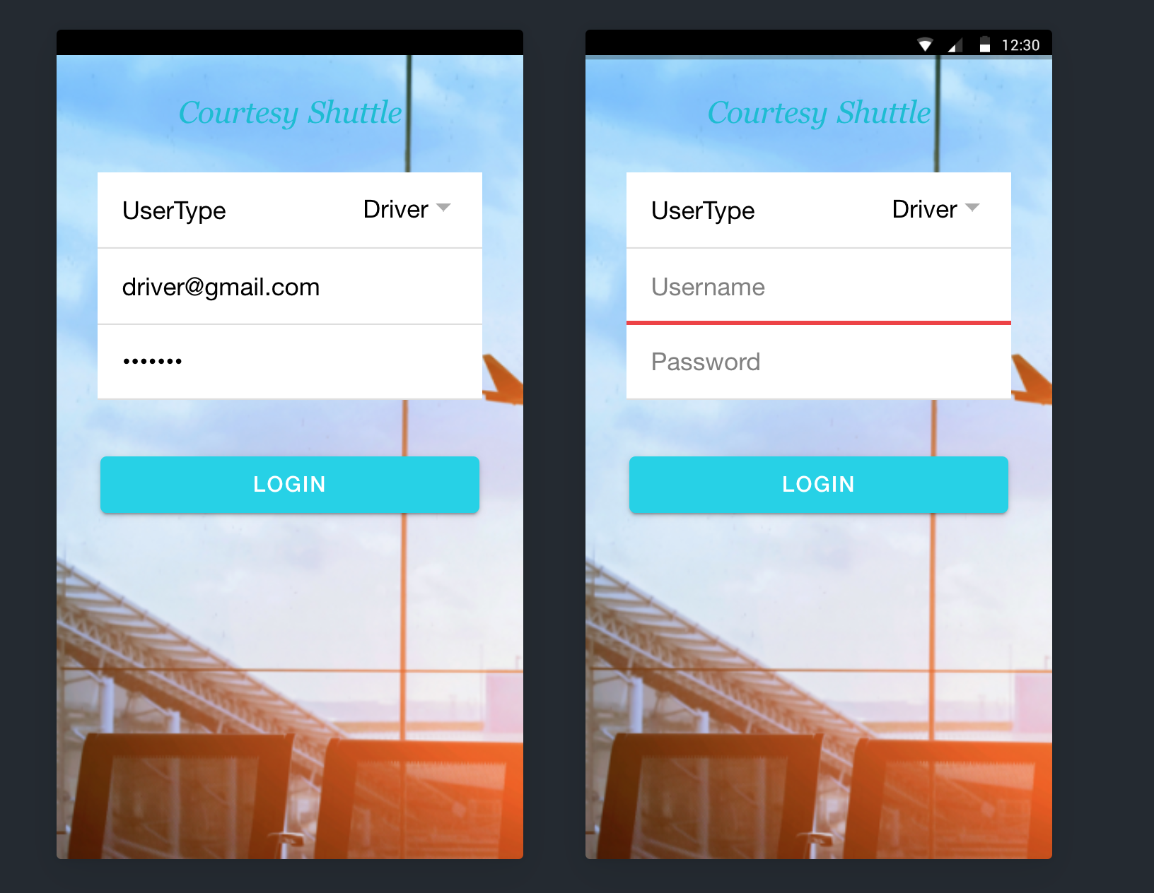
Driver Login

Slide 14
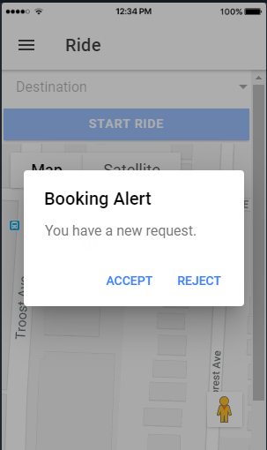
Driver Booking Alert

Slide 15
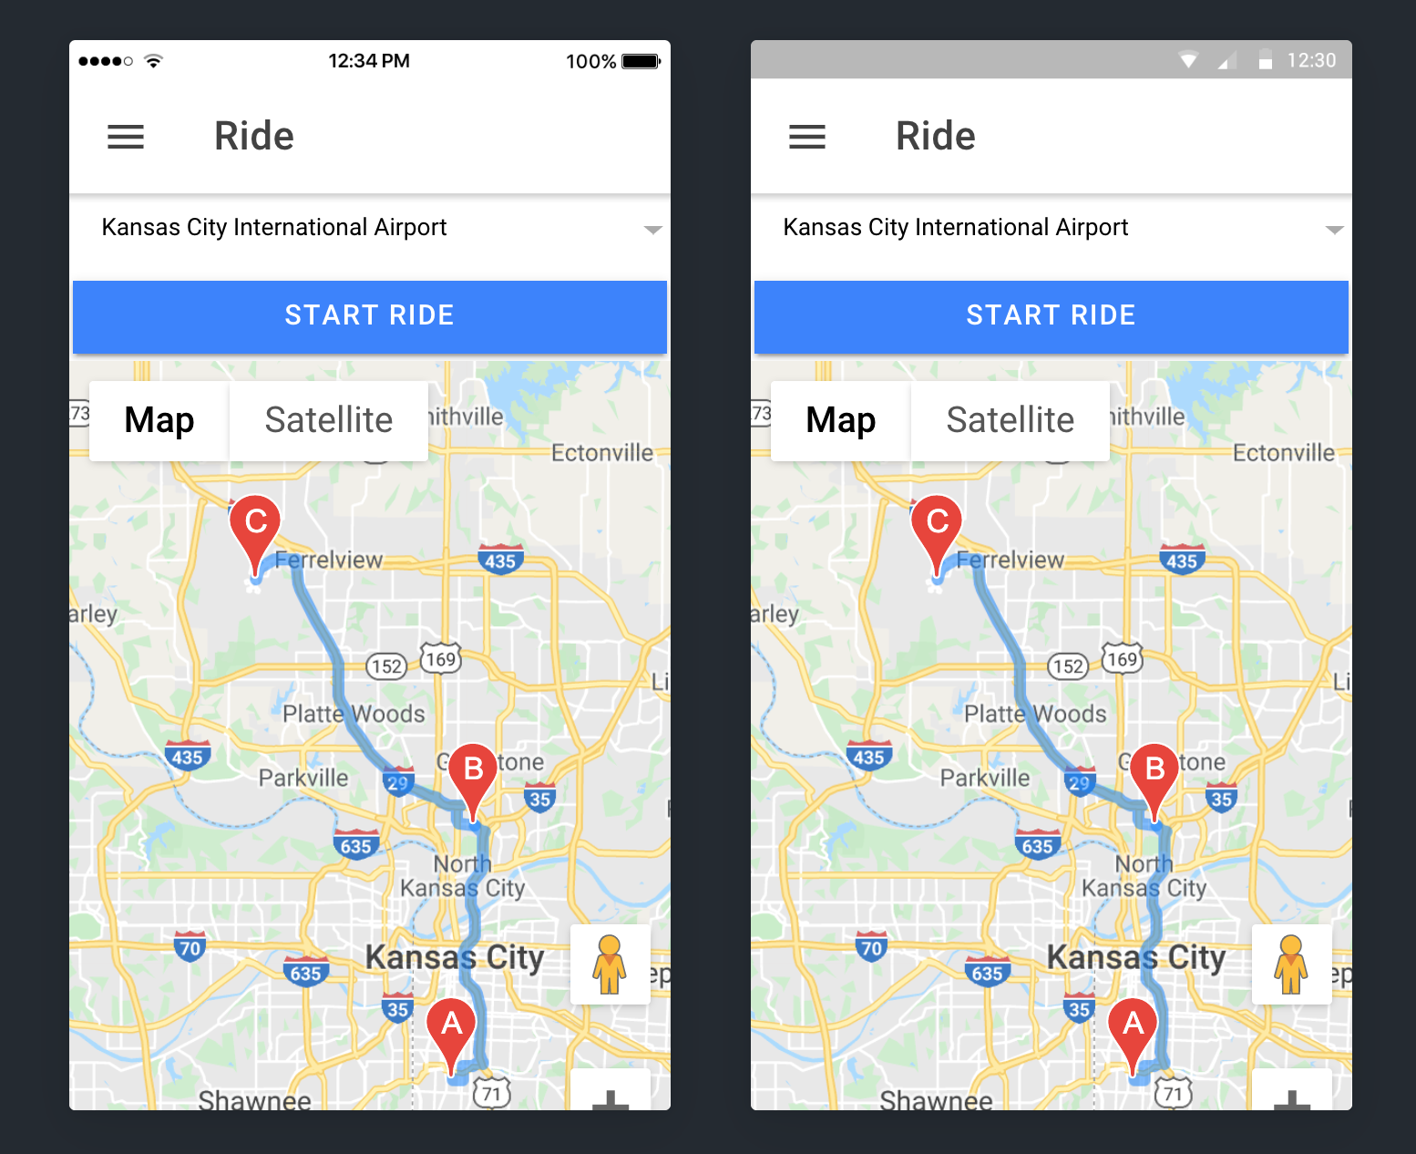
View Pickup Requests

Slide 16
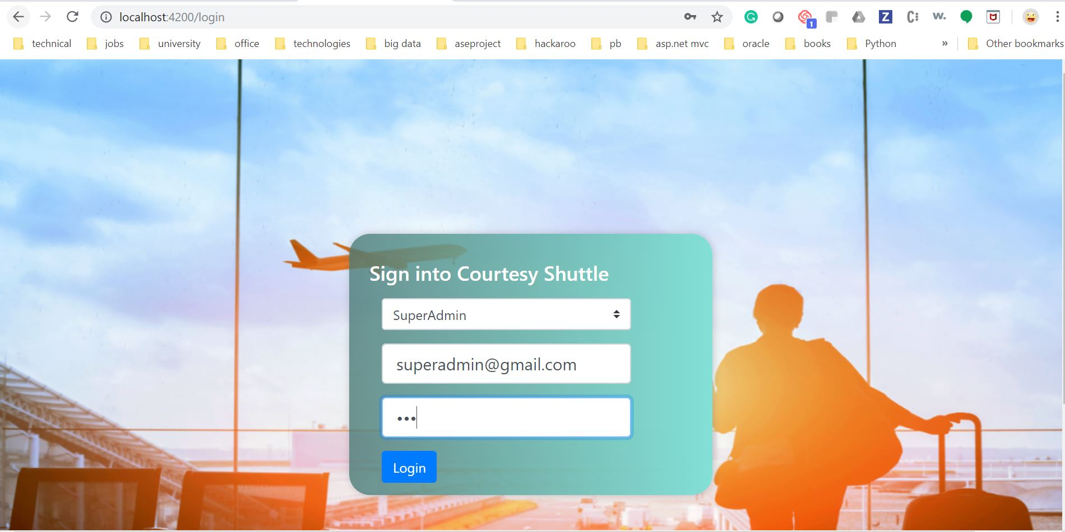
App Owner Login in

Slide 17
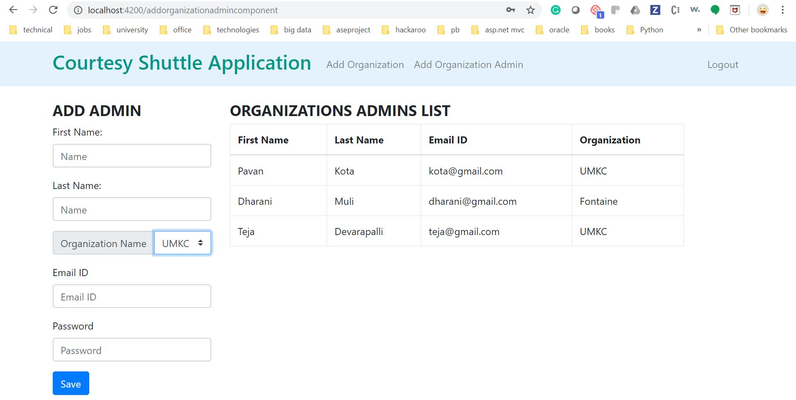
Add &View Organization Admin

Slide 18
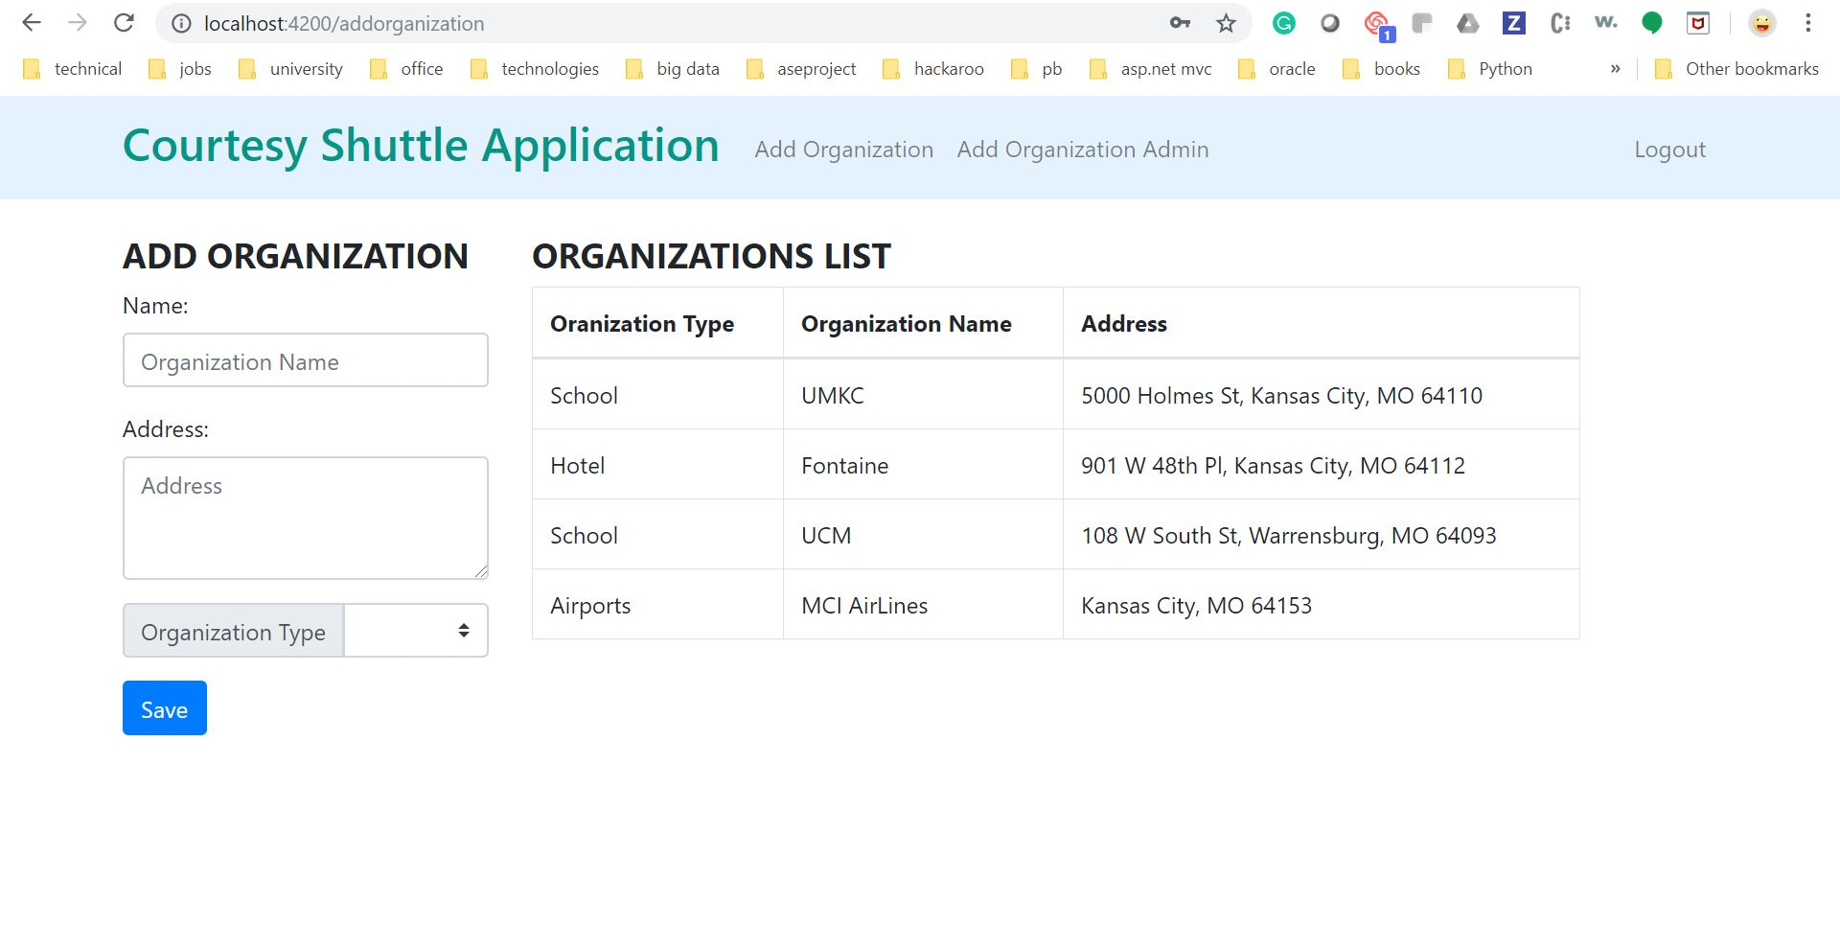
Add & View Organization

Slide 19

Organization Admin Login

Slide 20
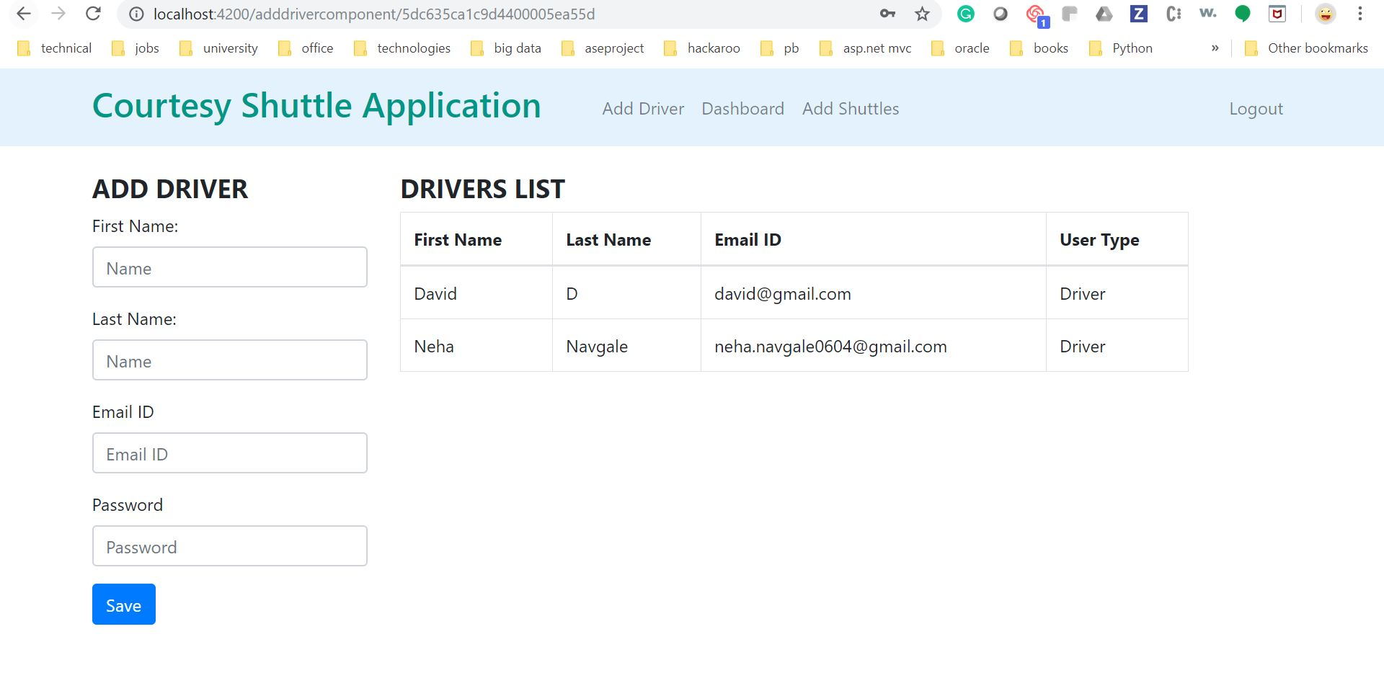
Add & View Driver

Slide 21
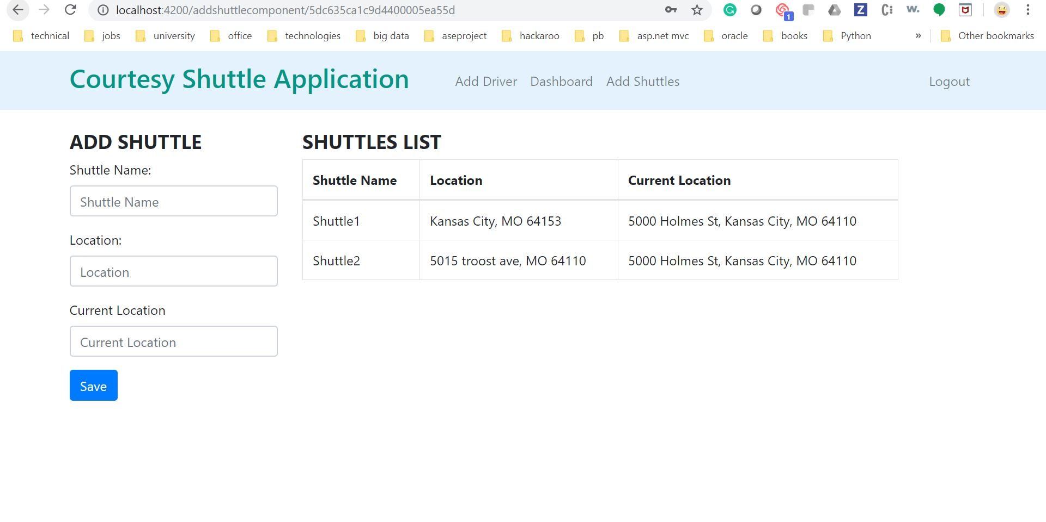
Add &View Shuttle

Slide 22
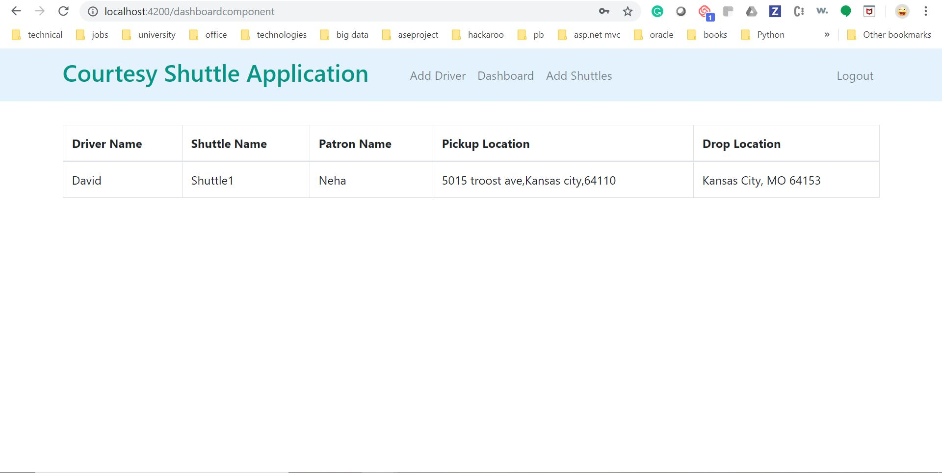
Organization Admin Dashboard

Slide 23
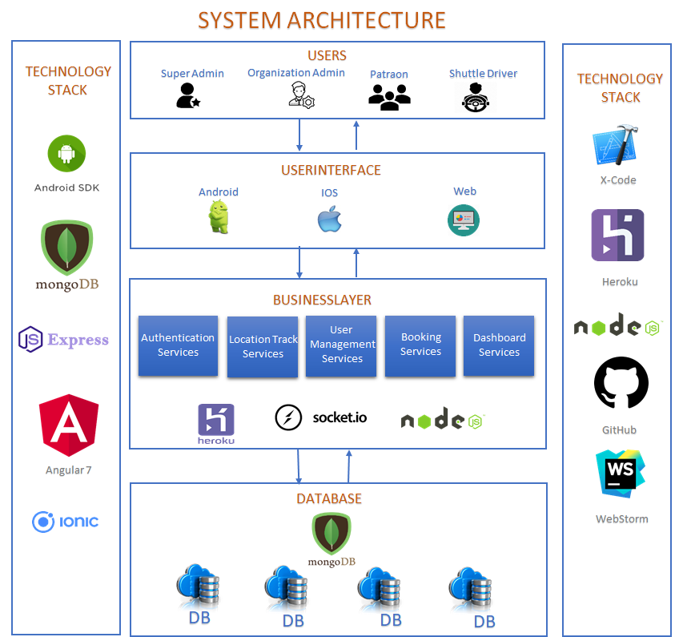
System Architecture

Slide 24
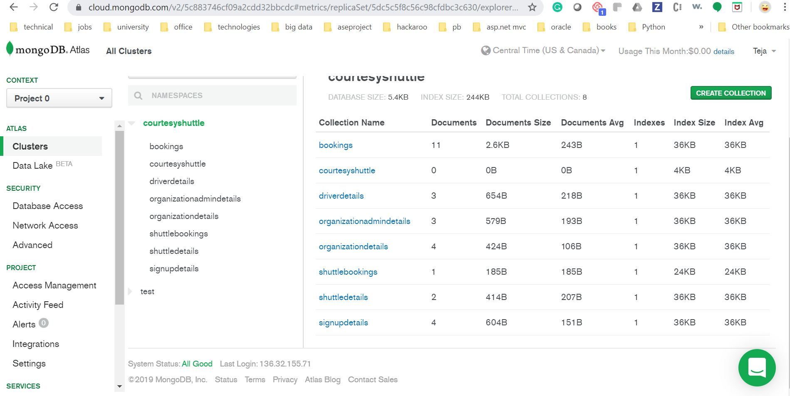
DB Architecture

Slide 25
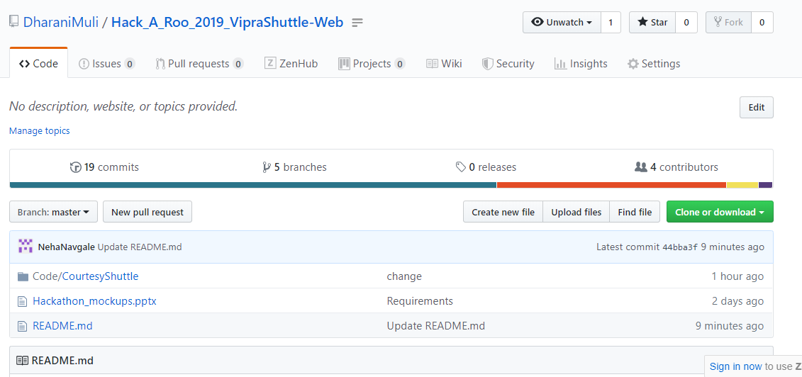
https://github.com/DharaniMuli/Hack_A_Roo_2019_VipraShuttle-Web

Slide 26
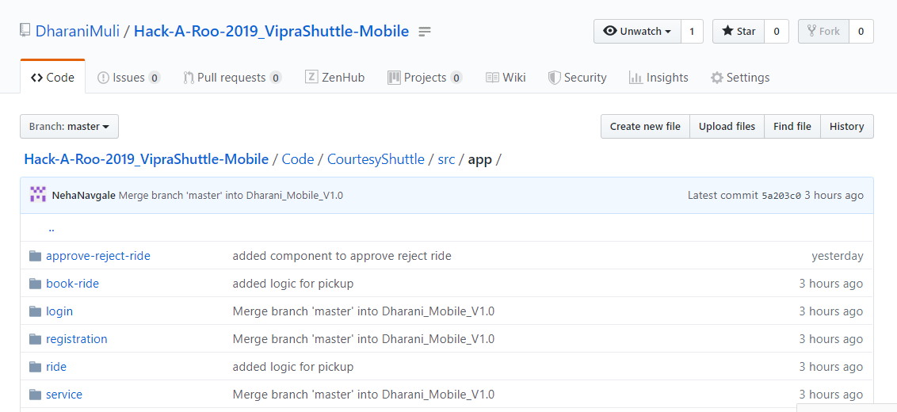
https://github.com/DharaniMuli/Hack-A-Roo-2019_VipraShuttle-Mobile

Slide 27
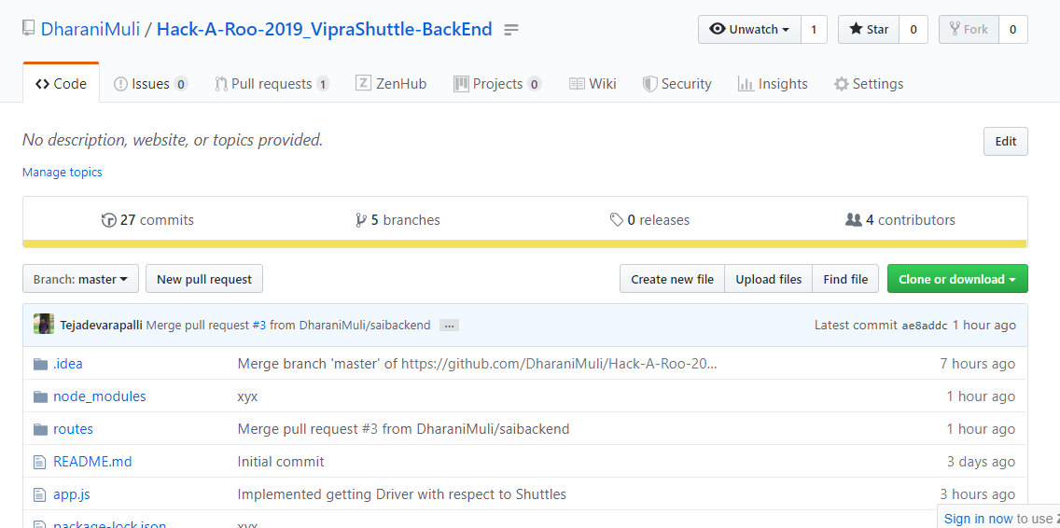
https://github.com/DharaniMuli/Hack-A-Roo-2019_VipraShuttle-BackEnd

Slide 28
#Hack-A-Roo2019
Thank you
Part 1(Web Application):
https://www.youtube.com/watch?v=N2GGm5MdVwY&feature=youtu.be
Part 2(Cross Plat formMobile Application): https://www.youtube.com/watch?v=pstdoGueMw0&feature=youtu.be

